Slide 1

Project Objectives and Status
Federico Corraro (CIRA)
01 July 2022

Slide 2






Outline
Project Objectives and Status
URClearED RWC Functional Concept
URClearED RWC Scenarios & Validation
Fast Time Simulation Highlights
Real Time Simulation Highlights
Conclusions

Slide 3
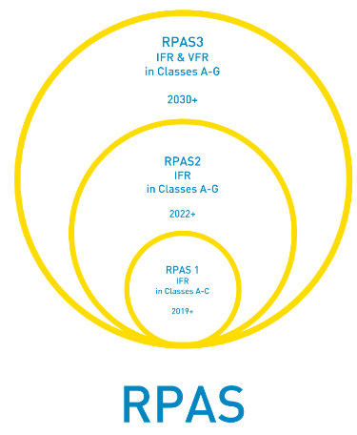
Project Scope
IFR RPAS INTEGRATION IN ATM
The seamless integration of a certified Remotely Piloted Aircraft Systems (RPAS) in non-segregated airspace is one of the major objectives for the worldwide civil aviation system.
Several technological and regulatory issues persist to comply with the need of keeping high safety levels of air transport.
The development of a Detect And Avoid (DAA) system is widely recognized as a primary need for the RPAS integration in the unsegregated airspace.
Many activities are ongoing all around the world that can support the development of effective and reliable DAA systems.

Slide 4
Aim of URClearED Exploratory Research project
Investigate the Definition of a Remain Well Clear (RWC) Software module, integrated in a Detect & Avoid (DAA) system, for:
  an RPAS of “Certified” EASA category;
  flying IFR (Instrumental Flight Rules)
  operating in airspace classes D to G
Project Objectives (all related to Classes D to G)
Define the operating conditions (Operational Scenarios) of a European RWC and related constraints in terms of sensors and C2 Radio Link.
Propose the functional requirements and capabilities for such RWC.
Propose operational procedures for RWC and the management of IFR RPAS flying in airspace classes D-G, including U-Space interaction.
Develop a baseline RWC prototype algorithm and related HMI to support evaluation of assumptions and requirements.
Assess and refine assumptions, requirements and operational procedures by means of Fast-Time and Real-Time Human in the Loop (including Remote Pilots and ATCOs) Simulations.

Slide 5
Project WorkFlow and Status
Define & Build Simulation Facilities
FTS & RTS Integration & Test Execution (Two Sessions)
Analyse State of Art for Scenarios
Define Operational Scenarios
Test Plan
Lesson Learned & Recommendations
Analyse State of Art for RWC
Define RWC Requirement
Baseline RWC Prototype
Refinement
Project KO
01 May 2020
Status @
30 June 2022

Slide 6
THANK YOU FOR
YOUR ATTENTION

