Slide 1

Remain Well Clear Concept
Gianluca Corraro (CIRA)
01 July 2022

Slide 2
Remain Well Clear High Level Objective
REMAIN WELL CLEAR: TACTICAL LAYER OF CONFLICT MANAGEMENT
The URClearED solution is focused on the RWC function to support the remote pilot in her/his responsibilities with regards to the rule of the air “An aircraft shall not be operated in such proximity to other aircraft as to create a collision hazard”, as stated in the ICAO Annex II, section §3.2. In this context, the RWC function will support the RPAS pilot to avoid the violation of a well-clear volume for any conflicting intruder.
Conflicting intruder: For each surrounding traffic track, a conflicting intruder is any aircraft for which it is predicted an estimated loss of well clear (LoWC) within a given look ahead time.
Well Clear Volume is a volume around each intruder that shall be not violated to avoid a Loss-of-Well Clear condition. In this context, the Well Clear Volume is quantitatively defined using horizontal thresholds, both spatial and temporal, and a vertical spatial threshold.

Slide 3
RWC Concept
FUNCTIONAL CONTEXT

Slide 4
RWC Concept
OPERATIONAL CONTEXT
RWC Range of Operativity
ATCo

Slide 5
URClearED RWC Functions
ALERTS
The alerting functionality aims to determine whether an intruder poses enough risk to warrant an alert and, in this case, which alert priority is appropriate.
ADVISORY (Light-Blue Traffic Symbols)
  Indicating when a change in current heading/track or altitude by either the ownship or intruder may trigger a caution alert. No alert is issued.
  The RP response to an advisory indication is to monitor the designated traffic, by assessing the overall situation of the encounter, and be aware of the risk of inducing a loss of well clear situation, due to possible future manoeuvres or mission constraints.
  Contacting ATC in response to an advisory indication should be avoided.
CAUTION (Yellow Traffic Symbols)
  An aural and visual alert is raised that necessitates immediate reaction of the RP.
  Indicating a predicted (within a given look-ahead time) or current loss of well clear situation (no use of flight plan).
  The RP shall determine whether a manoeuvre is needed and initiate coordination with ATC if available.

Slide 6
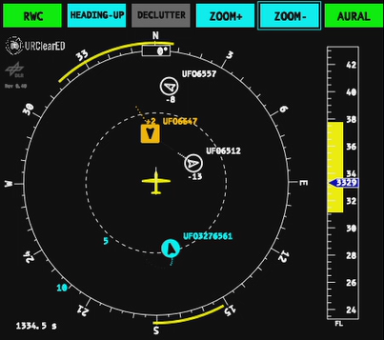
URClearED RWC Functions
GUIDANCE
Provide indications to support the RP (or other involved operators of the RPAS) decisions in the resolution of a potential conflict.
Computes the range of ownship manoeuvres that would result in an estimated loss of well clear (LoWC) within a given look ahead time.
Manoeuvres are computed only for Horizontal and Vertical Plane separately.
Horizontal manoeuvres are computed in track/heading angle.
Vertical manoeuvres are computed in altitude or Flight Levels.
All information is shown to the remote pilot in a CDTI (Cockpit Display of Traffic Information) inspired to what specified in the RTCA-DO-365.

Slide 7
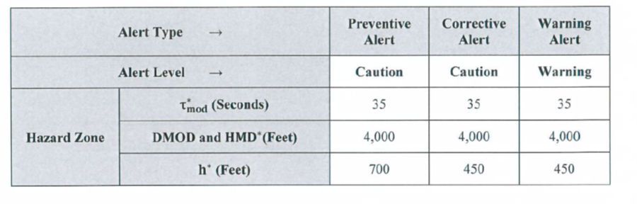
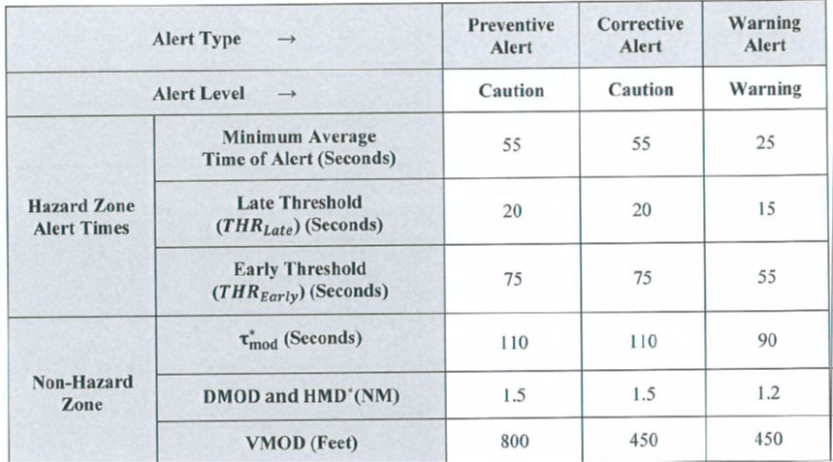
URClearED RWC Functions
Differences between U.S. and European RWC
DO-365 Well Clear Volume
Follow EUROCAE ED-258 guidelines for airspace class D-G, taking as baseline the existing US RTCA DO-365 research but considering European peculiarities.
Dimensions of Well Clear Volume revised and based on FTS and EUROCONTROL CAFÉ encounter model
Removed DO-365 Warning Alerts because RP in classes D and E are not allowed to perform maneuvers without clearance from ATCo
Advisory Indication defined differently from DO-365
Caution Alert Times revised and based on FTS and EUROCONTROL CAFÉ encounter model
Different behaviour in encounters with ACAS equipped intruders (always try to avoid Resolution Advisory)
Simplification and reduction of information to essential ones for the HMI
Definition of RP Operational Procedures compliant with current European Air Traffic Management rules
DO-365 Alerting Times

Slide 8
Operating Procedures
Airspace Class | Intruder Type | RP behaviour during the assessment task
D-E | IFR | ATC provide full separation. Remote Pilot monitor the traffic information and execute the separation instructions provided by ATC. The RWC system would alert and give guidance in case the ATC does not timely provide any information about the type of intruder (IFR/VFR) and/or separation instructions The Remote Pilot (RP) shall contact ATC to inform them and to ask for instructions or clearance for an RWC manoeuvre
D-E | VFR | ATC send traffic info about VFR traffic on a regular basis (in class D), or when possible (in class E). VFR traffic shall normally separate The RWC system would alert and give guidance to RP in case the VFR traffic is not separating The Remote Pilot shall interact with ATC to determine a course of action. After clearing the conflict, the RP shall recover the original flight plan by contacting back ATC
G | IFR and VFR | ATC does not provide any separation or traffic information services. The IFR RPAS RP shares separation responsibility with the intruder The RWC System would alert and give guidance to RP in case of conflicting intruders, together with information on type of intruder (coop./non coop, ACAS equip.), as far as practicable The Remote Pilot, using RWC indications, decides the maneuver according to the rules of the air, simply notifying ATC, if available. After clearing the conflict, the RP will contact ATC, if available, in order to return to the original flight path.

Slide 9
Differences with existing (manned) situation
Current Operations in manned aviation | URClearED expected operations and capabilities
Responsibility for separation management is assigned to the air traffic controller. However, the pilot is responsible for remaining well clear from other traffic | In the URClearED operational concept the roles and responsibilities for ATC and remote pilots are the same as current manned aviation operations
In all the situations in which ATC does not provide the separation service, a manned aircraft can only rely on see-and-avoid capability of the pilot, eventually supported by ACAS-I Traffic advisories (TAs) | The DAA RWC function issues at most the advisory (for monitoring traffic) and caution alerts (for action). The RWC gives guidance indications that would support the RP in taking decisions when interacting with ATC, if available, or for maneuvering. The alerting timeframe of RWC on an IFR RPAS is always sufficient for interacting with ATC, while not conflicting with ATC separation.
TCAS-I is optional for any aircraft, TCAS-II is mandatory within European Union only for large aircraft. In the airspace classes from D to G, there can be aircraft not equipped by a transponder. | The URClearED RWC solution is supported by a surveillance function that provides to the RP the surrounding air traffic situation including not transponder or ACAS equipped aircraft

Slide 10
THANK YOU FOR
YOUR ATTENTION

