Slide 1

Remain Well Clear Concept
Gianluca Corraro (CIRA)
01 July 2022

Slide 2
Remain Well Clear High Level Objective
REMAIN WELL CLEAR: TACTICAL LAYER OF CONFLICT MANAGEMENT
The URClearED solution is focused on the RWC function to support the remote pilot in her/his responsibilities with regards to the rule of the air “An aircraft shall not be operated in such proximity to other aircraft as to create a collision hazard”, as stated in the ICAO Annex II, section §3.2. In this context, the RWC function will support the RPAS pilot to avoid the violation of a well-clear volume for any conflicting intruder.
Conflicting intruder: For each surrounding traffic track, a conflicting intruder is any aircraft for which it is predicted an estimated loss of well clear (LoWC) within a given look ahead time.
Well Clear Volume is a volume around each intruder that shall be not violated to avoid a Loss-of-Well Clear condition. In this context, the Well Clear Volume is quantitatively defined using horizontal thresholds, both spatial and temporal, and a vertical spatial threshold.

Slide 3
RWC Concept
FUNCTIONAL CONTEXT

Slide 4
RWC Concept
OPERATIONAL CONTEXT
RWC Range of Operativity
ATCo

Slide 5
URClearED RWC Functions
ALERTS
The alerting functionality aims to determine whether an intruder poses enough risk to warrant an alert and, in this case, which alert priority is appropriate.
ADVISORY (Light-Blue Traffic Symbols)
  Indicating when a change in current heading/track or altitude by either the ownship or intruder may trigger a caution alert. No alert is issued.
  The RP response to an advisory indication is to monitor the designated traffic, by assessing the overall situation of the encounter, and be aware of the risk of inducing a loss of well clear situation, due to possible future manoeuvres or mission constraints.
  Contacting ATC in response to an advisory indication should be avoided.
CAUTION (Yellow Traffic Symbols)
  An aural and visual alert is raised that necessitates immediate reaction of the RP.
  Indicating a predicted (within a given look-ahead time) or current loss of well clear situation (no use of flight plan).
  The RP shall determine whether a manoeuvre is needed and initiate coordination with ATC if available.

Slide 6
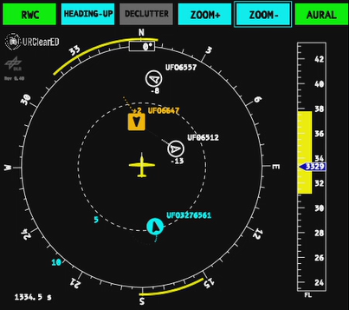
URClearED RWC Functions
GUIDANCE
Provide indications to support the RP (or other involved operators of the RPAS) decisions in the resolution of a potential conflict.
Computes the range of ownship manoeuvres that would result in an estimated loss of well clear (LoWC) within a given look ahead time.
Manoeuvres are computed only for Horizontal and Vertical Plane separately.
Horizontal manoeuvres are computed in track/heading angle.
Vertical manoeuvres are computed in altitude or Flight Levels.
All information is shown to the remote pilot in a CDTI (Cockpit Display of Traffic Information) inspired to what specified in the RTCA-DO-365.

Slide 7
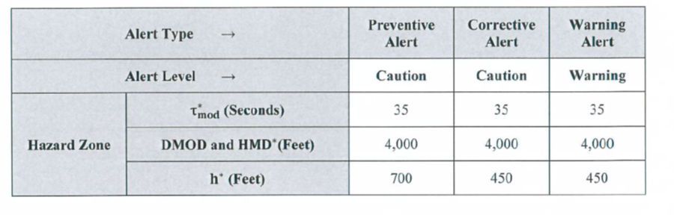
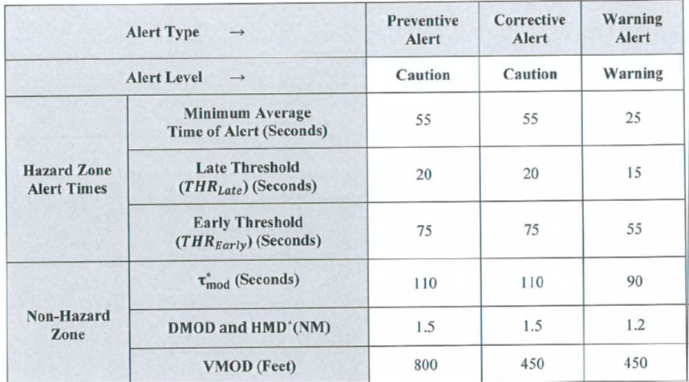
URClearED RWC Functions
Differences between U.S. and European RWC
DO-365 Well Clear Volume
Follow EUROCAE ED-258 guidelines for airspace class D-G, taking as baseline the existing US RTCA DO-365 research but considering European peculiarities.
Dimensions of Well Clear Volume revised and based on FTS and EUROCONTROL CAFÉ encounter model
Removed DO-365 Warning Alerts because RP in classes D and E are not allowed to perform maneuvers without clearance from ATCo
Advisory indications defined differently from DO-365
Caution Alert Times revised and based on FTS and EUROCONTROL CAFÉ encounter model
Different behaviour in encounters with ACAS equipped intruders (always try to avoid Resolution Advisory)
Simplification and reduction of information to essential ones for the HMI
Definition of RP Operational Procedures compliant with current European Air Traffic Management rules
DO-365 Alerting Times

Slide 8
THANK YOU FOR
YOUR ATTENTION

