Slide 1

Operational Scenario and Validation Process
Federico Corraro (CIRA)
01 July 2022

Slide 2
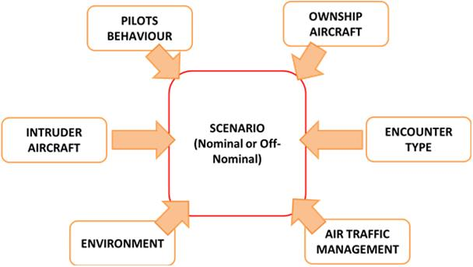
Operational Scenario
KEY ELEMENTS
Airspace and available Air Traffic Services.
Ownship / Intruder performance and equipment.
Encounter Types: geometries, speeds.
Remote Pilot Behavior and Environment

Slide 3
Operational Scenario
AIRSPACE and AIR TRAFFIC SERVICES
Airspace Class | D |  | E |  |  | G
Flight Rules | IFR | VFR | IFR | VFR |  | IFR | VFR
Permitted | yes | yes | yes | yes |  | yes | yes
Speed Limitation | < 250 Kts, @ Altitudes below 10.000 feet AMSL
ATC Clearance | yes | yes | yes | no |  | no | no
Air-Ground Radio Comm. Requ. | Continuous two ways | Continuous two ways | Continuous two ways | no |  | Continuous two ways | no
Separation minima | 2.5 nm horizontal 1000ft vertical |  | 5 nm horizontal 1000ft vertical |  |  | 3 nm horizontal 500ft vertical
ATC Separation Services | yes only IFR-IFR | no | yes only IFR-IFR | no | no | no | no
ATC Information | TFCI wrt VFR | TFCI wrt IFR and VFR | TFCI wrt VFR when possible | TFCI when possible | TFCI when possible | FIS If requested | FIS If requested

Slide 4
Operational Scenario
OWNSHIP PERFORMANCE
OWNSHIP | Tactical UAV | MALE
Ceiling (ft) | 19500 | 40000ft
TAS (kts) | Range 50÷90 (< 10000ft) Range 50:80 (>10000 ft) | 60-140
Vertical Speed (ft/min) | ± 500 | ± 1500
Max Bank Angle (deg) | 30 | 30
Max Turn Rate (deg/s) | 3 | 3
Max Speed Derivative (m/s^2) | 2 | 2
All RPAS are Transponder Equipped, with Cooperative Sensors (ADSB-IN + Active Traffic Sensor or Interrogator) and a Non-Cooperative Sensor Suite (radar, EO/IR, etc.)
Ownship Model | Min. Cruise Speed (m/s) | Cruise Speed (m/s) | Max. Cruise Speed (m/s) | Max. Climb rate (m/s) | Standard Mass (kg)
M360 | 20 | 72 | 80 | 5.08 | 450
Volocopter 2X | 0 | 22 | 28 | 3 | 450
DexHawk | 0 | 20 | 25 | 5 | 10
SuperARTIS | 0 | 18 | 35 | 12 | 10

Slide 5
Operational Scenario
INTRUDER AIRCRAFT PERFORMANCE
Level | Equipment | Categories | IAS [Kts] | RoC [ft/min] | Max turn rate [deg/s] | Max vert acc [g]
0 | Non-cooperative | Piston fixed wing | 77-98 | -1500/2000 | 6 | 0.25
 |  | Piston rotary wing, glider, balloon, airship | 0-98 | -1200/1200 | 30
1 | Cooperative without cooperative traffic sensors | Piston fixed wing | 77-98 | -1500/2000 | 6 | 0.25
 |  | Piston rotary wing | 0-102 | 1200/1200 | 30
2-3 | Cooperative with cooperative traffic sensors | Turboprop < 15000 Kg (2,3) | 92-150 | -3700/4200 | 6 | 0.25
4 | Cooperative with ACAS | Turboprop > 5700 Kg (3,4) | 110-160 | -3510/3550 | 5 | 0.15
 |  | Turbojet (6,7,9) | 108-210 | -4500/4650 | 5 | 0.25
 |  | Turbine rotary wing | 0-155 | -2000/2000 | 30 | 0.25
 |  | Tilt Rotor | 0-275 | -4100/4100

Slide 6
Operational Scenario
ENCOUNTER TYPES
ENCOUNTER TYPE
Conflict Geometry
Complexity of the Encounter
Right of Way Rules
Conflict Geometry (w.r.t. Ownship):
Head On (level flight and climbing)
Lateral with Right of Way
Lateral without Right of Way
Overtaking
Complexity of the encounter:
Simple Pair Wise: Straight Trajectories
Special Maneuvers: CAFE’ trajectories; RTCA DO 365A trajectories;
Multi-intruders

Slide 7
Validation Objectives
RWC System Performances
  Performance / Safety in nominal conditions (success rate, nuisance rate, etc.)
  Interoperability with on-board Collision Avoidance function
  Interoperability with ACAS equipped traffic
  Interoperability with Air Traffic Control separation service
  Interoperability with Visual Flight Rules of Manned aircraft
Impact of contingency situations on safety (data link loss, failures, etc.)
Human Performance
  Roles, responsibilities, operating methods, and human tasks
  Technical support systems and Human-Machine Interface
  Team structure and Communication
Acceptability
  Remote Pilot and Controller Acceptability
  Remote Pilot and Controller Competence

Slide 8
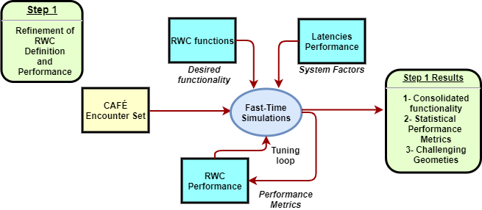
Validation Strategy – Step 1
Fast-time analysis of a large generic encounter set (with straight trajectories) for quantification of the reference Well Clear Volume, which can be space and time based, and related time thresholds for generating the Caution Alerts that require attention and possible actions by the Remote Pilot
Generic Encounter Set
3 – RWC Par. Tuning

Slide 9
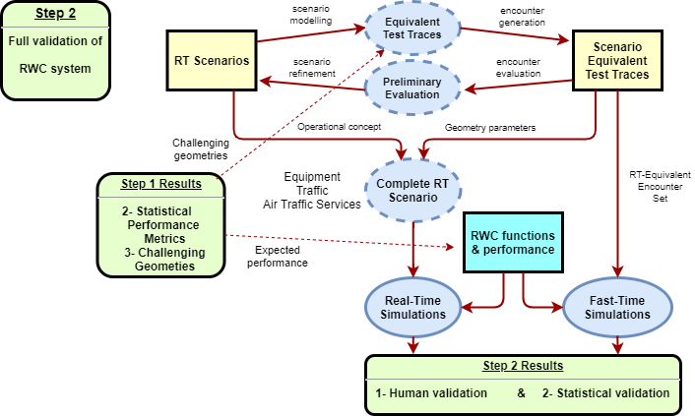
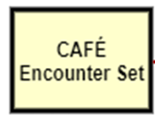
Validation Strategy Step 2
Get probabilistic distributions (Eurocontrol CAFÉ toolset) with Fast Time Simulation
Real-time Simulation based on selection of relevant scenarios from Use Cases and selected parameters.
1 – Test Traces
2 - DWC Volume

Slide 10
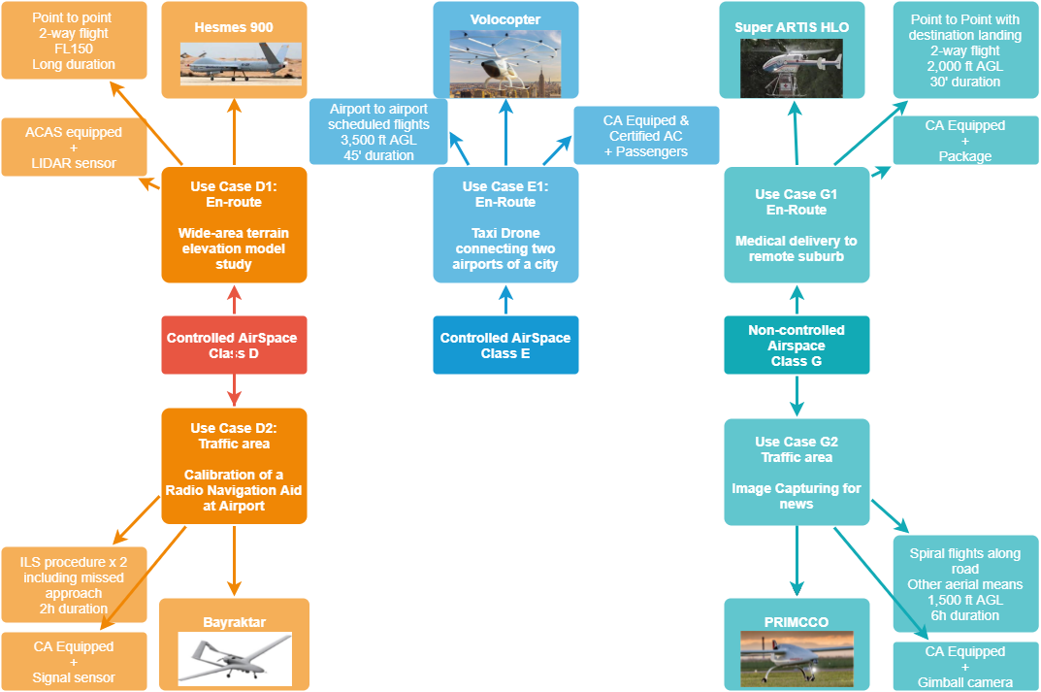
Validation Step 2 – RTS Analysis
Five Use Case Scenarios

Slide 11
THANK YOU FOR
YOUR ATTENTION

