Slide 1

Enric Pastor
01 July 2022

Slide 2
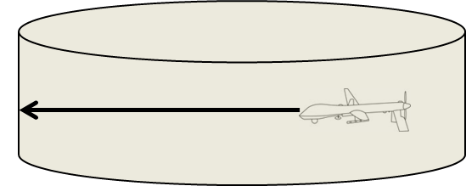
Validation Step 1 – RWC Determination
PARAMETERS
Horizontal spatial threshold (HST)
Horizontal temporal threshold (HTT)
Vertical spatial threshold (VST)
Caution Alert time (CAT)
HTT τmod w/ HST dist
VST
Differentiation by intruder type and Altitude <FL100 and >FL100.
Resulting to 6 set of parameters.
METHODOLOGY
Define a possible list of Well Clear Volumes and Alerting Times to be analysed from other projects/standards with some modification, if needed
Select a host vehicle performance, an intruder class and the altitude range
Perform a Montecarlo analysis in which encounters with generic geometries are uniformly generated and the RWC algorithm is applied with any of above Well Clear Volumes and considering straight trajectories
The Montecarlo Analysis is performed using a Simulation tool that implements a model of RWC Software.

Slide 3
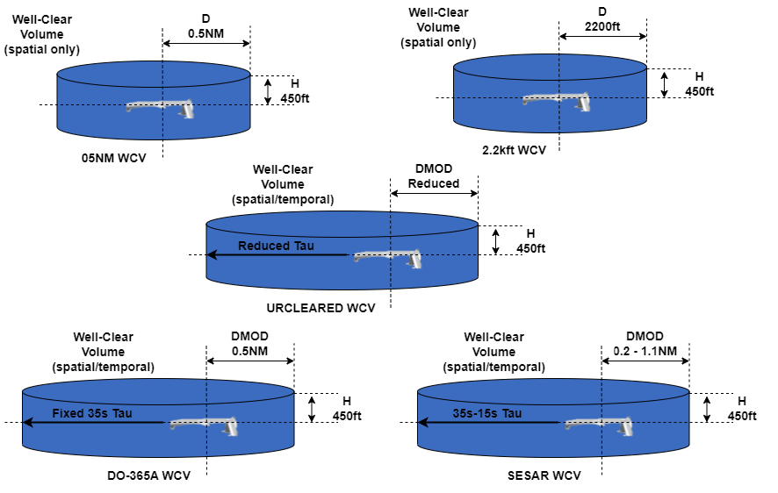
Validation Step 1 – RWC Determination
DWC SELECTION
Different RWC volumes are defined and evaluated, either with DMOD and TAUMOD components. Each volume is associate to a subset of encounters sub-classification:

Slide 4
Validation Step 1 – RWC Determination
General Criteria Used
Time Difference between Caution Alert and RWC Last Manoeuvre > Latency of RP/ATC interaction/C2 Link. This would guarantee that RP has enough time to perform RWC. Assume about 10s for non-coop. and 20s for cooperative for latency
Time Difference between RWC Last Manoeuvre and Resolution Advisory Alert or Collision Avoidance Last Manoeuvre > 0. This would guarantee that RP has time until Regain Well Clear to perform RWC, before Collision Avoidance.
Range at Caution Alert < surveillance sensor ranges. This would allow that the intruder can be detected by the sensors at CAT. Assume 7NM for non coop. and 14NM for coop.
Time at Caution Alert < ATCo Acceptable Times for cooperative intruders. This would guarantee not Overlapping ATC indications. Assume an average time from 60s to 90s acceptable (see NASA investigation).
Range at Caution Alert < Visual Range for non-cooperative intruders. Allow intruder that has only Visual Based Separation to see Ownship. Assume 4NM or below for visual range.

Slide 5
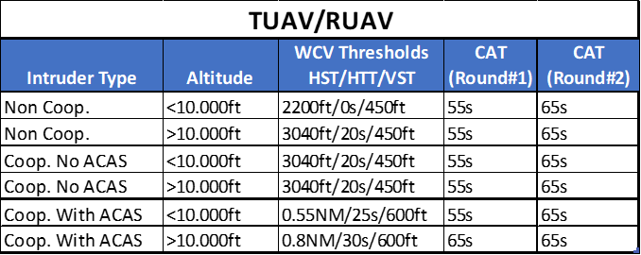
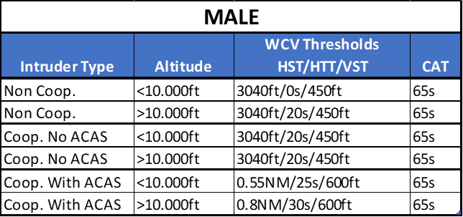
Validation Step 1 – RWC Determination
RESULTS
Low Performance Ownship
High Performance Ownship

Slide 6
Validation Step 1 – RWC Determination
RESULTS
Tcat: Caution Alert
Twcla: RWC Last Maneuver
Tra: Resolution Alert

Slide 7
Validation Step 2 – FTS Probabilistic Analysis
Objectives
Statistical characterization of relevant RWC parameters through fast-time analysis of EUROCONTROL CAFE’ trajectories database Rev-6-7.
Methodology
Open loop evaluation (no pilot response).
Encounters filtering in terms of altitude of the encounters and equipment of intruders (Non-cooperative, Cooperative, ACAS equipped).
Classification of the encounters in terms of type of caution alerts.
Identification of relevant parameters for the statistical analysis.
Measure Distributions, Mean and STD deviation of the relevant parameters with reference to the type of alerts identified, by analysing the relative occurrences in the ECTL CAFE’ database of flight traces, in its revisions 6 and 7.

Slide 8
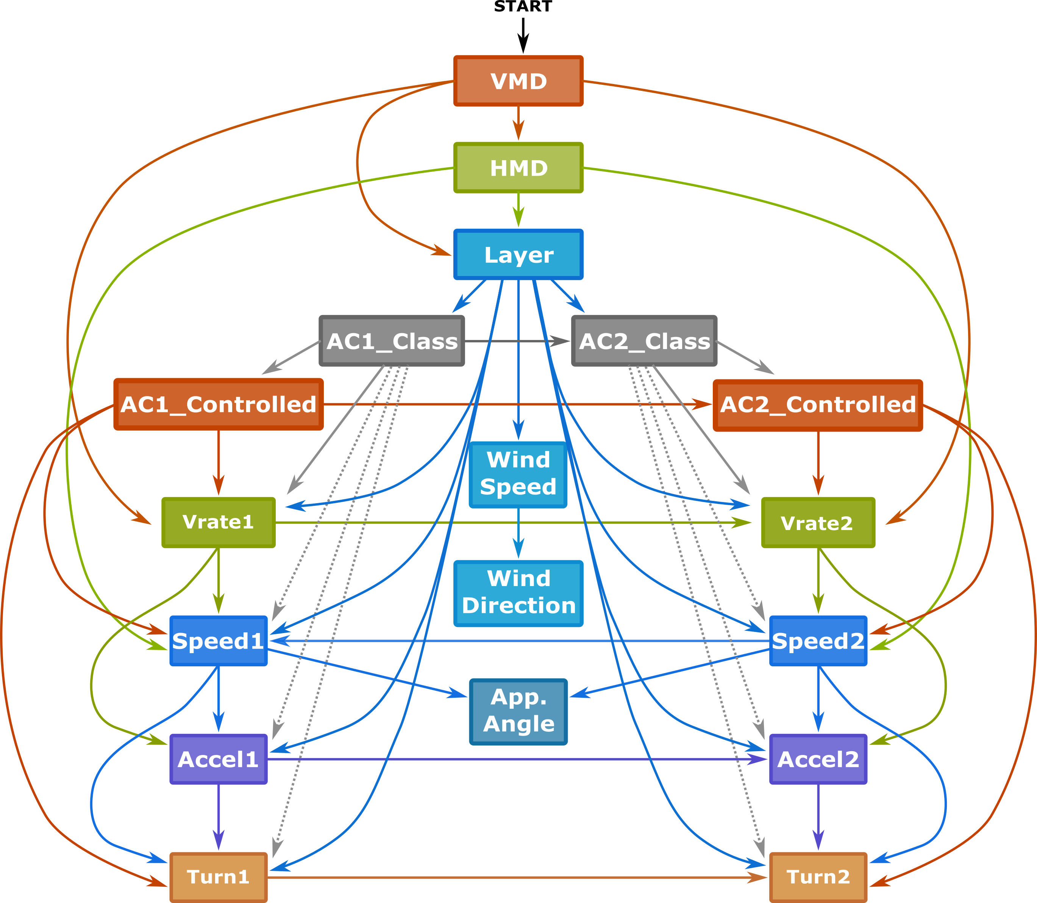
Validation Step 2 – FTS Probabilistic Analysis
Encounter Modelling
CAFÉ: Bayesian Network modelling toolset for CA and RWC analysis:
Over 12 million flight hours of European radar data were collected.
Adjustments to Bayesian network order, bin sizes, and nodes (aircraft class, controlled status, proximity, vertical separation from ATC level).
An aircraft model instead of airspace model, with aircraft performance classes.
A wind model with wind speed and direction changing with altitude.
Initial Network

Slide 9
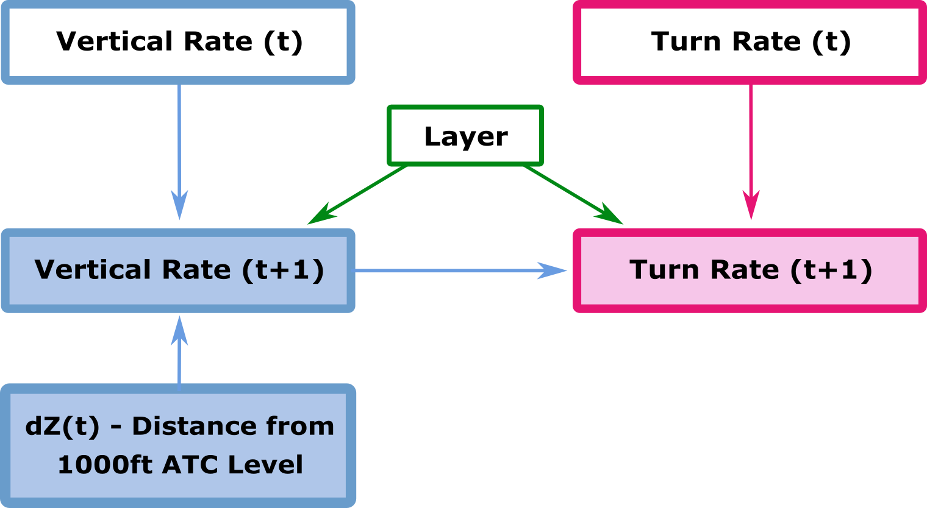
Validation Step 2 – FTS Probabilistic Analysis
Encounter Modelling
CAFÉ: Bayesian Network modelling toolset for CA and RWC analysis:
Over 12 million flight hours of European radar data were collected.
Adjustments to Bayesian network order, bin sizes, and nodes (aircraft class, controlled status, proximity, vertical separation from ATC level).
An aircraft model instead of airspace model, with aircraft performance classes.
A wind model with wind speed and direction changing with altitude.
Transition Network

Slide 10
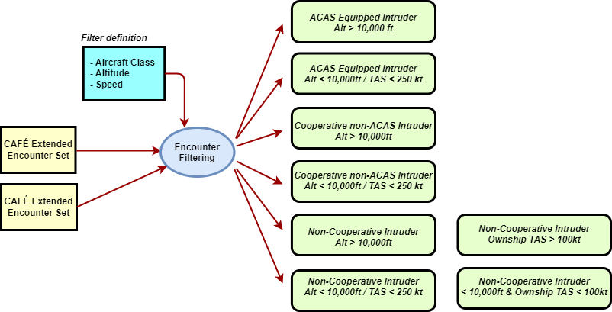
Validation Step 2 – FTS Probabilistic Analysis
Encounter Sub Classification
Encounters are sub-classified to evaluate various RWV functions and their behaviors depending on the operational scenario:

Slide 11
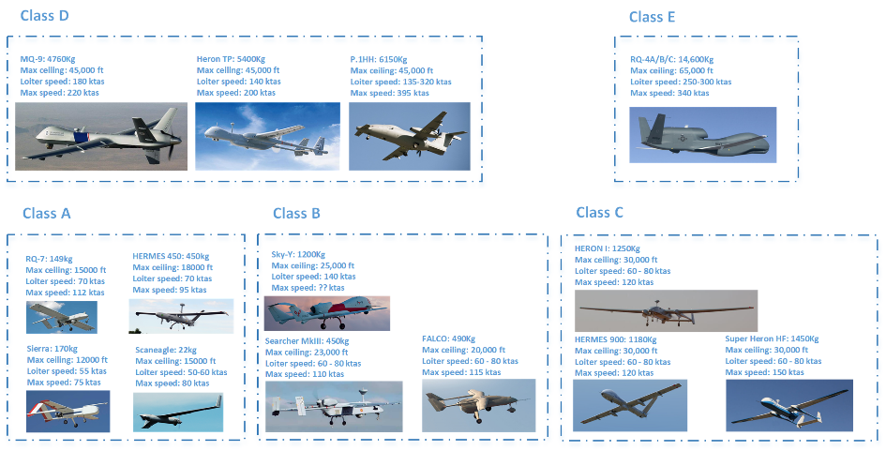
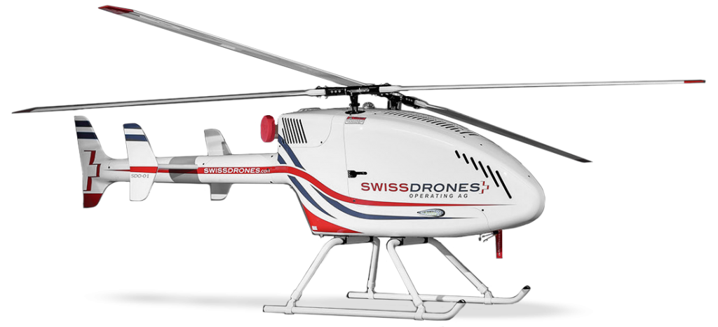

Validation Step 2 – FTS Probabilistic Analysis
Vehicle Sub Classification
Made compatible with Eurocontrol classifications:
Fixed wing ‘certified’ RPAS from class A to E, classified based on engine type / ceiling.
Helicopter / VTOL: SMALL VTOL, UAM VTOL
C2 Link RLOS and BRLOS
All RPAS Transponder Equipped, with Cooperative Sensors (ADSB-IN + Active Traffic Sensor or Interrogator) and Non-Cooperative Sensor Suite (radar, EO/IR, etc.)
SMALL VTOL
MTOW : 87kg
Max Ceiling 3000m AMSL
Max speed 72 km/h
UAM VTOL
MTOW : 900kg
Max Range 65 km
Max speed 110 km/h

Slide 12
Validation Step 2 – FTS Probabilistic Analysis
Sample of Results
 | Total conflict number: CAFÉ REV6
Encounter Identification | WCV | Spurious Caution | Active Caution | LoWC | No Caution LoWC | NMAC
ACAS-High 120,245 | SESAR | 4,267 3.54% | 9,393 7.81% | 2,673 2.22% | 490 0.40% | 43 0.03%
 | DO365 | 4,866 4.04% | 11,744 9.76% | 3,100 2.57% | 564 0.46% | 43 0.03%
ACAS-Low 144,878 | SESAR | 9,052 6.24% | 37,584 25.94% | 21,706 14.98% | 1,396 0.96% | 410 0.28%
 | DO365 | 9,044 6.24% | 46,555 32.13% | 33,237 22.94% | 4,688 3.23% | 410 0.28%

Slide 13
Validation Step 2 – FTS Probabilistic Analysis
Sample of Results
 | Total conflict number: CAFÉ REV6
Encounter Identification | WCV | Spurious Caution | Active Caution | LoWC | No Caution LoWC | NMAC
Coop-High 11,596 | 05NM | 337 2.90% | 477 4.11% | 253 2.18% | 0 | 2 0.01%
 | 22KFT | 290 2.50% | 352 3.03% | 194 1.67% | 0 | 2 0.01%
 | URCV | 279 2.40% | 337 2.90% | 219 1.88% | 33 0.28% | 2 0.01%
Coop-Low 5,252 | 05NM | 286 5.44% | 831 15.82% | 597 11.36% | 0 | 11 0.2%
 | 22KFT | 285 5.42% | 627 11.93% | 428 8.14% | 0 | 11 0.2%
 | URCV | 268 5.10% | 670 12.75% | 583 11.10% | 90 1.71% | 11 0.2%

Slide 14
Validation Step 2 – FTS Probabilistic Analysis
Sample of Results
 | Total conflict number: CAFÉ REV6
Encounter Identification | WCV | Spurious Caution | Active Caution | LoWC | No Caution LoWC | NMAC
NonCoop-High 7,446 | 05NM | 227 3.04% | 331 4.44% | 169 2.26% | 0 | 1 0.01%
 | 22KFT | 204 2.73% | 236 3.16% | 127 1.70% | 0 | 1 0.01%
 | URCV | 188 2.52% | 227 3.04% | 147 1.97% | 23 0.3% | 1 0.01%
NonCoop-Low 9,543 | 05NM | 537 5.62% | 1,685 17.65% | 1,250 13.09% | 0 | 18 0.18%
 | 22KFT | 504 5.28% | 1,264 13.24% | 895 9.37% | 0 | 18 0.18%
 | URCV | 518 5.42% | 1,315 13.77% | 1,156 12.11% | 170 1.78% | 18 0.18%

Slide 15
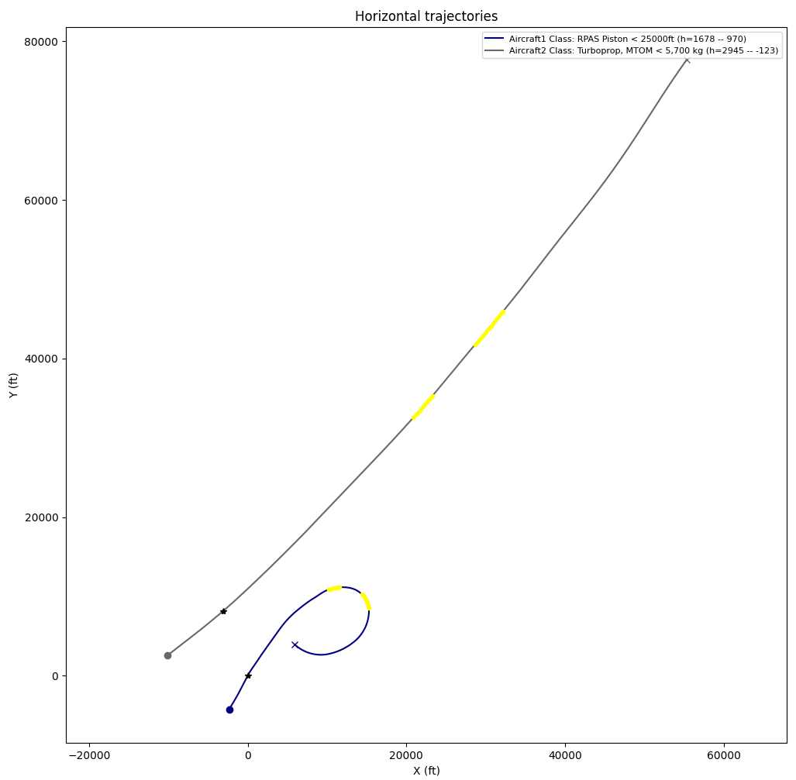
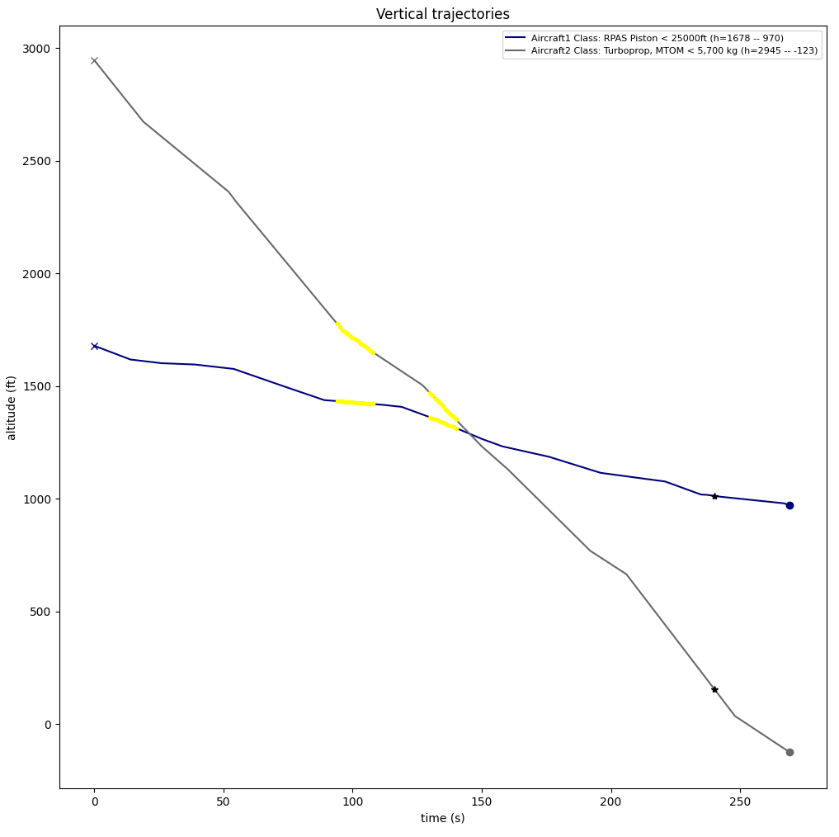
Validation Step 2 – FTS Probabilistic Analysis
Analysis Strategy: Short/Intermittent Caution Alerts not leading to LoWC
Occur due to the large amount of maneuvers during encounters:
Time to predicted LoWC, duration of Caution alert, etc.
Distance between aircraft, etc.
Question: can be considered as a nuisance?
Answer: no factor make them different from other Caution alerts, only distance at CPA

Slide 16
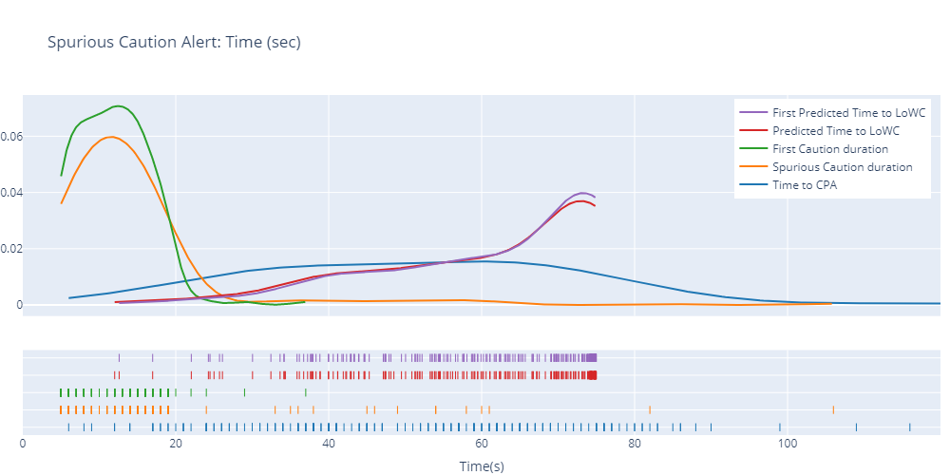
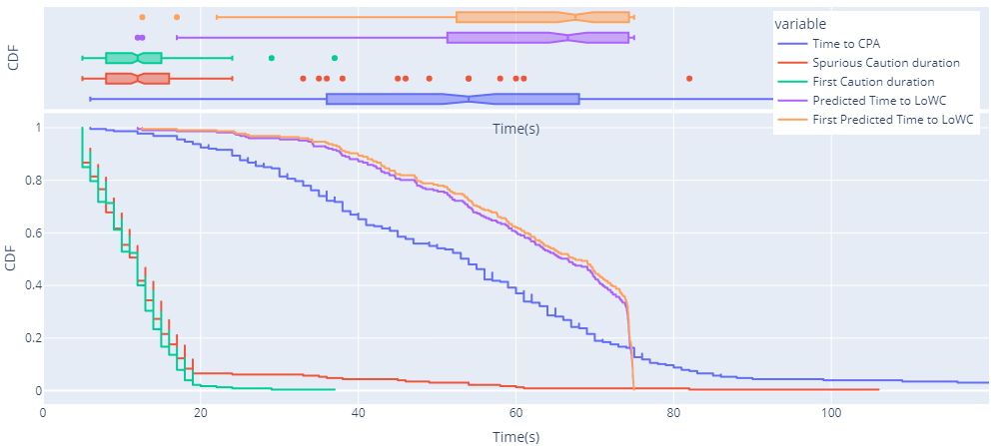
Validation Step 2 – FTS Probabilistic Analysis
Analysis Strategy: Short/Intermittent Caution Alerts not leading to LoWC
Combined probability diagrams help us understand the variable behavior and make comparisons:
Probability density function (PDF)
Cumulative distribution function (CDF)
Box plots.
How short/intermittent Caution alerts are distributed:
Time to LoWC/CPA
First vs Last Caution
Caution duration
Non-cooperative higher airspace 05NM WCV

Slide 17
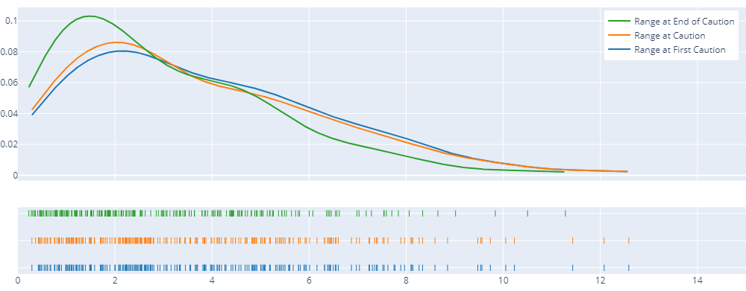
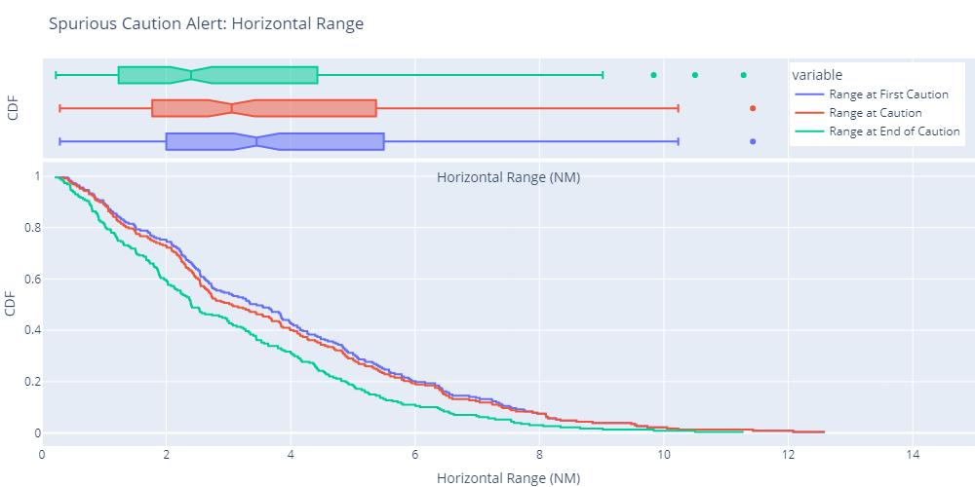
Validation Step 2 – FTS Probabilistic Analysis
Analysis Strategy: Short/Intermittent Caution Alerts not leading to LoWC
How short/intermittent Caution alerts are distributed:
Range at first Caution
Range at last Caution
Range at end of Caution
Non-cooperative higher airspace 05NM WCV

Slide 18
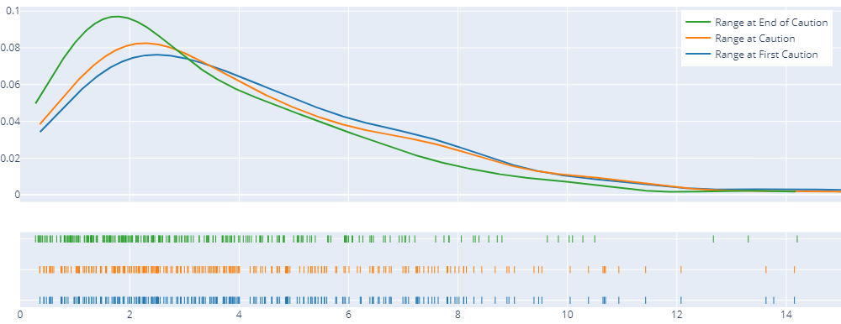
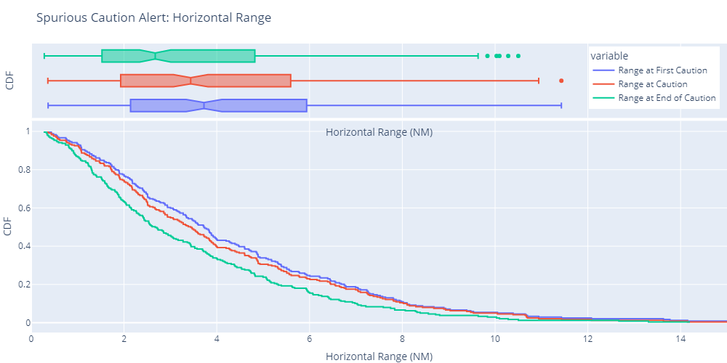
Validation Step 2 – FTS Probabilistic Analysis
Analysis Strategy: Short/Intermittent Caution Alerts not leading to LoWC
How short/intermittent Caution alerts are distributed:
Range at first Caution
Range at last Caution
Range at end of Caution
Non-cooperative higher airspace URCV WCV

Slide 19
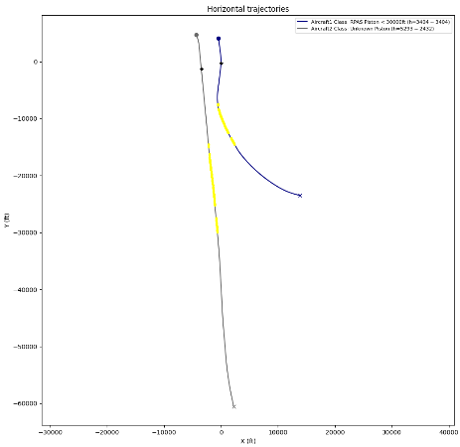
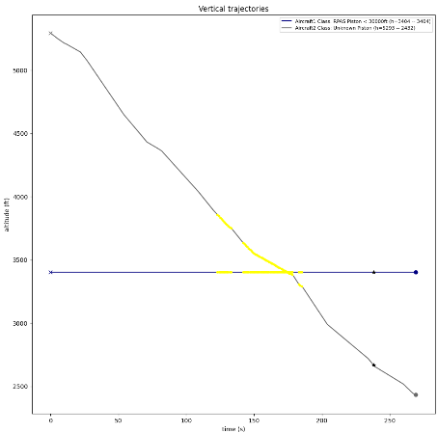
Validation Step 2 – FTS Probabilistic Analysis
Analysis Strategy: Long Caution Alerts or LoWC
Longer intersections with Caution alert volume, but no LoWC:
Time to predicted LoWC, caution alert duration, etc.
Distance between aircraft.
Question: Are they different from shorter Caution alerts?
Answer: No. Time to predicted LoWC, distance and probability distribution are alike.

Slide 20
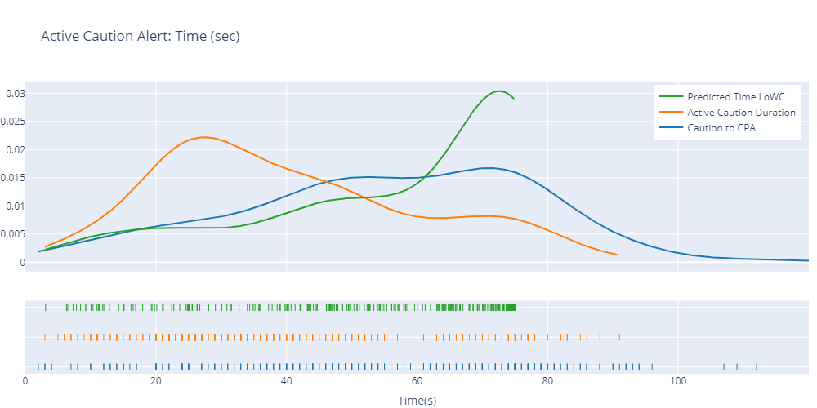
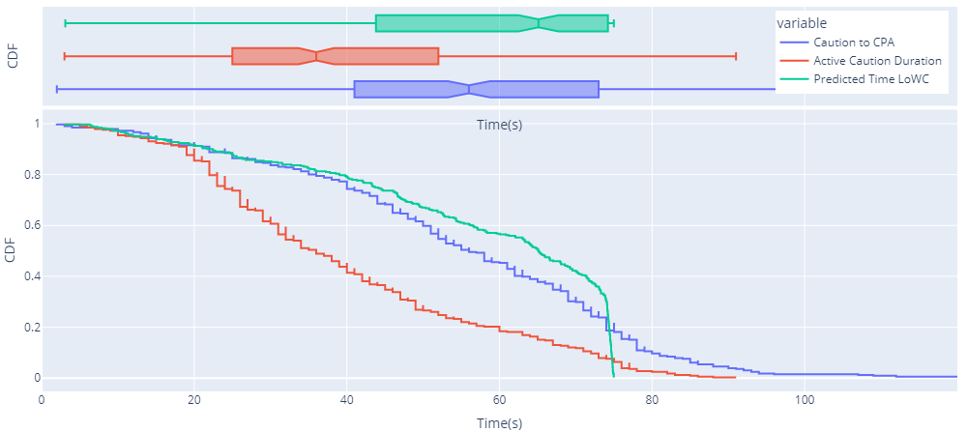
Validation Step 2 – FTS Probabilistic Analysis
Analysis Strategy: Long Caution Alerts or LoWC
Long Caution alerts are distributed:
Time to LoWC/CPA
Caution duration
Non-cooperative higher airspace 05NM WCV
Differential elements:
Time to LoWC/CPA not correlated
Lots of alerts at 75s time boundary
Caution duration 30-40 sec

Slide 21
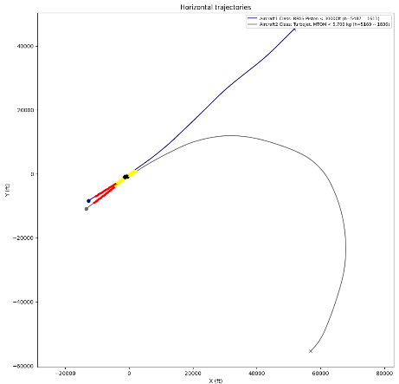
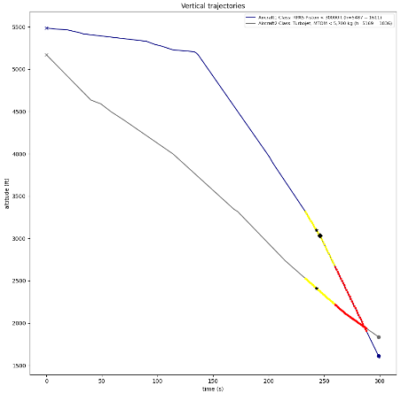
Validation Step 2 – FTS Probabilistic Analysis
Analysis Strategy: Unexpected behaviour for CPA
How should we define CPA (closest point of approach)?
Min horizontal distance? Min slat range?
CPA may be outside LoWC fragment, which complicates analysis.
Best alternative: WSLoWC (Worst Severity of Loss of Well-Clear)
What is SLoWC? Uniform metric [0-1] defined if LoWC that takes into account distance+time violation of WCV.

Slide 22
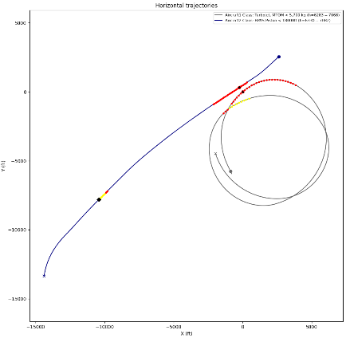
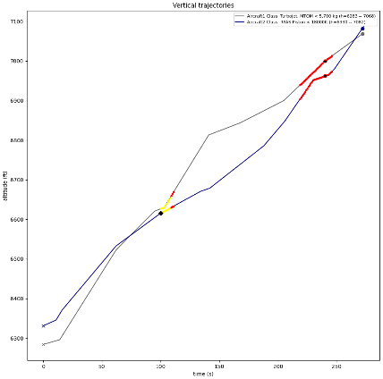
Validation Step 2 – FTS Probabilistic Analysis
Analysis Strategy: Unexpected behaviour with multiple LoWC
Each encounter may contain multiple sub-encounters:
Multiple Caution alerts.
Multiple LoWC.
Hard to determine which one is the most relevant (we select the last one).

Slide 23
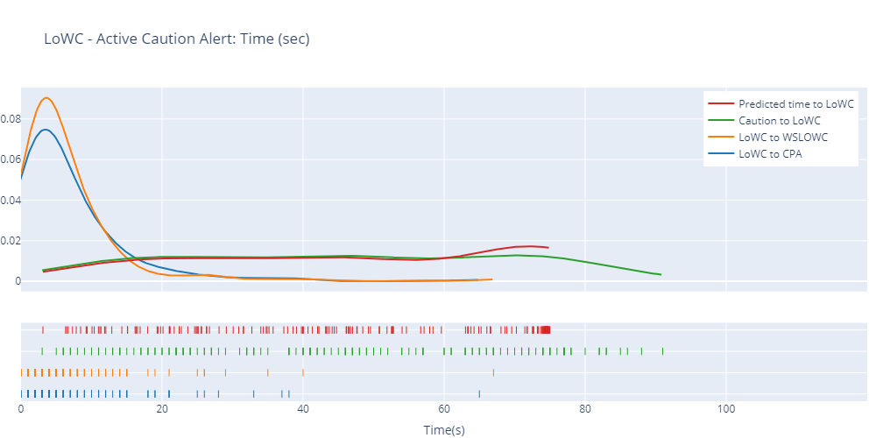
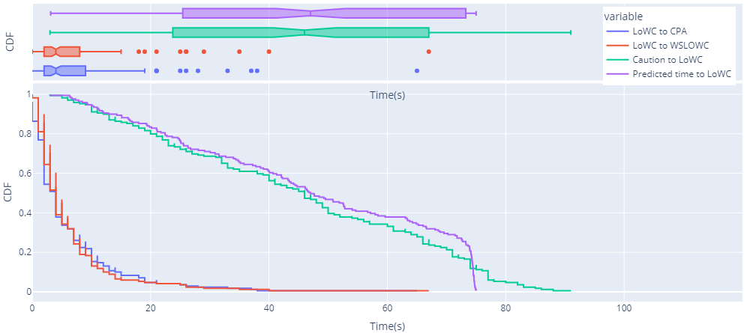
Validation Step 2 – FTS Probabilistic Analysis
Analysis Strategy: Caution Alerts and LoWC
Long Caution alerts are distributed:
Predicted time to LoWC
Time to LoWC
LoWC to CPA
LoWC to WSLoWC
Non-cooperative higher airspace 05NM WCV
Differential elements:
Time to LoWC dispersion
Very short LoWC - WSLoWC
CPA/WSLoWC are different.

Slide 24
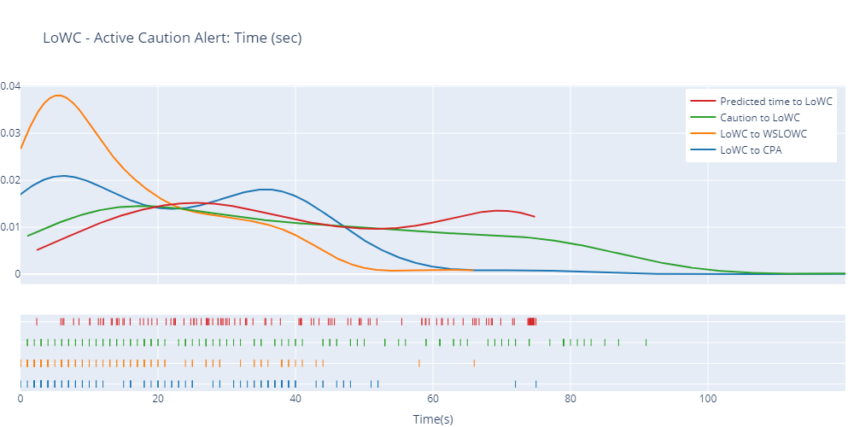
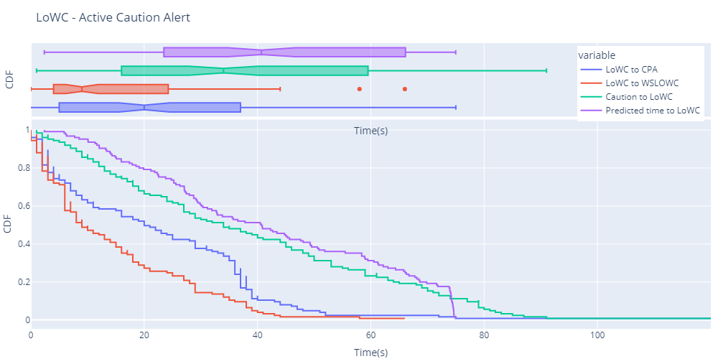
Validation Step 2 – FTS Probabilistic Analysis
Analysis Strategy: Caution Alerts and LoWC
Long Caution alerts are distributed:
Predicted time to LoWC
Time to LoWC
LoWC to CPA
LoWC to WSLoWC
Non-cooperative higher airspace URCV WCV
Differential elements:
More time to LoWC dispersion
Wider LoWC - WSLoWC
CPA/WSLoWC are different.

Slide 25
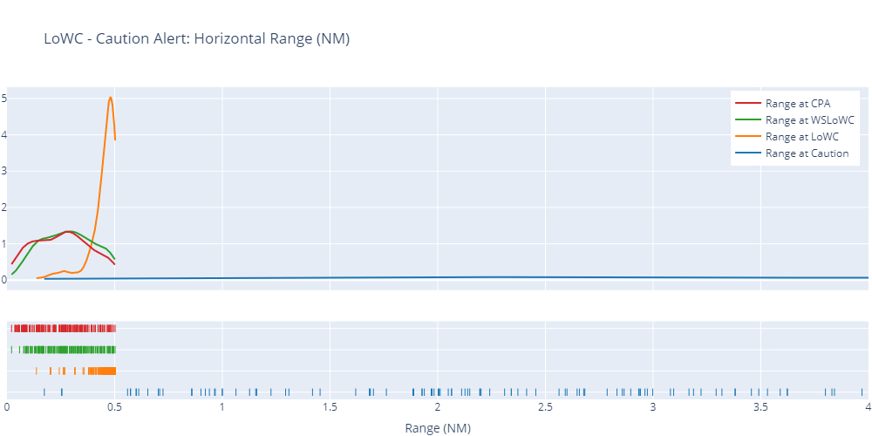
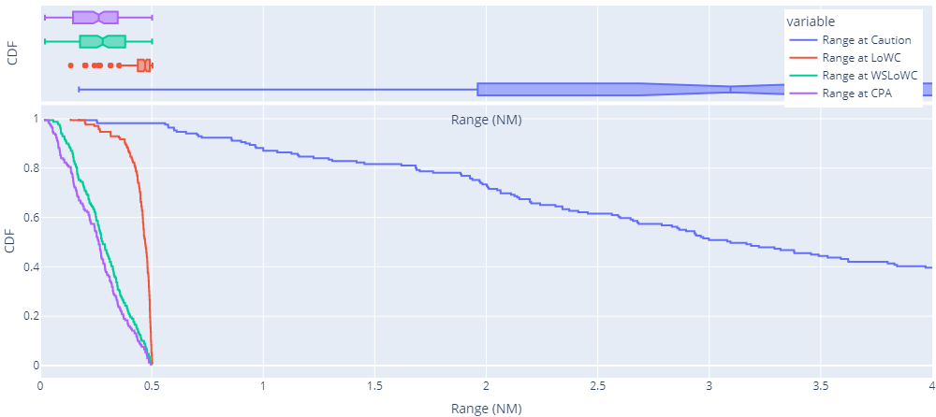
Validation Step 2 – FTS Probabilistic Analysis
Analysis Strategy: Caution Alerts and LoWC
LoWC are distributed:
Range at Caution
Range at LoWC
Range at CPA / WSLoWC
Non-cooperative higher airspace 05NM WCV
Differential elements:
Short distances involved
LoWC and WSLoWC within 0.5 NM
Caution alert at large distances

Slide 26
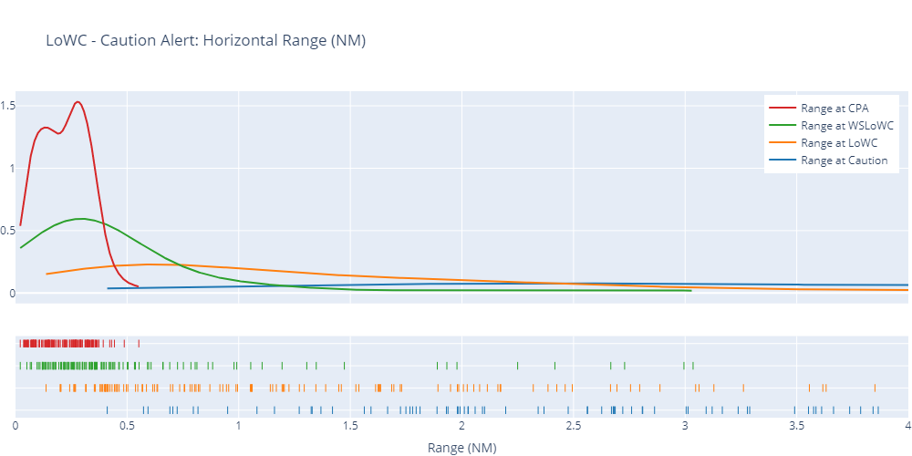
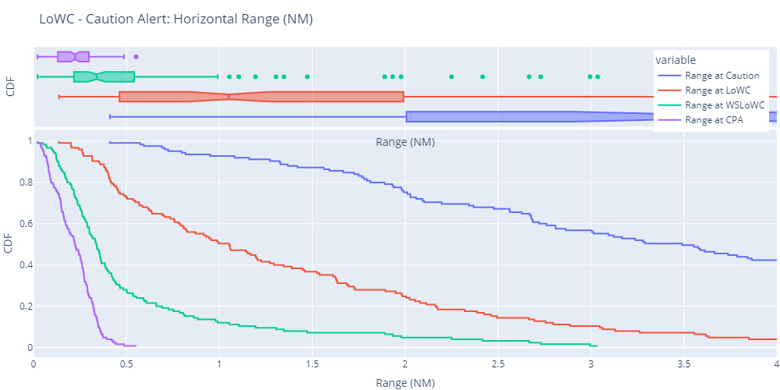
Validation Step 2 – FTS Probabilistic Analysis
Analysis Strategy: Caution Alerts and LoWC
LoWC are distributed:
Range at Caution
Range at LoWC
Range at CPA / WSLoWC
Non-cooperative higher airspace URCV WCV
Differential elements:
Wider distances involved
LoWC and WSLoWC beyond 1 NM
CPA differs from WSLoWC due to time component
WCV selection has limited impact on Caution alert

Slide 27
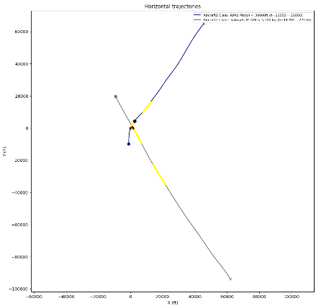
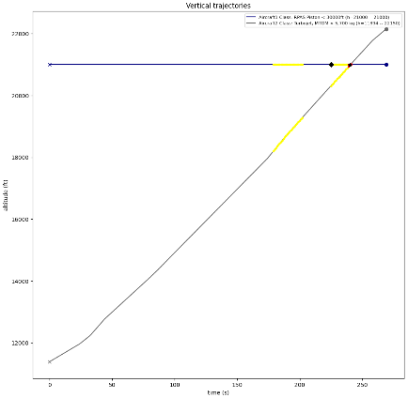
Validation Step 2 – FTS Probabilistic Analysis
Analysis Strategy: Caution Alerts / LoWC by example
22KFT Volume (DMOD):

Slide 28
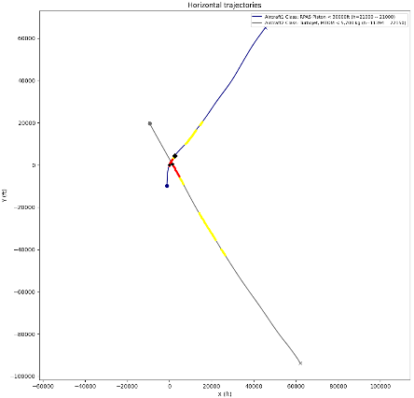
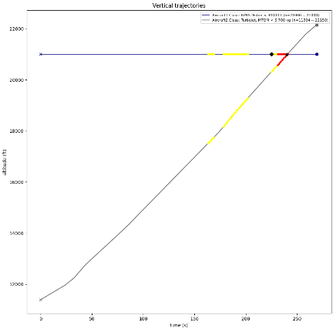
Validation Step 2 – FTS Probabilistic Analysis
Analysis Strategy: Caution Alerts / LoWC by example
URCV Volume (DMOD + Taumod):

Slide 29
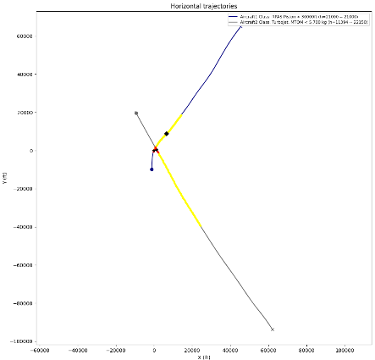
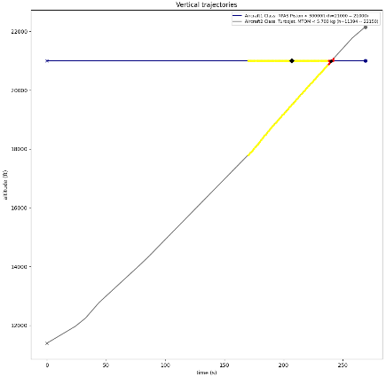
Validation Step 2 – FTS Probabilistic Analysis
Analysis Strategy: Caution Alerts / LoWC by example
05NM Volume (DMOD):

Slide 30
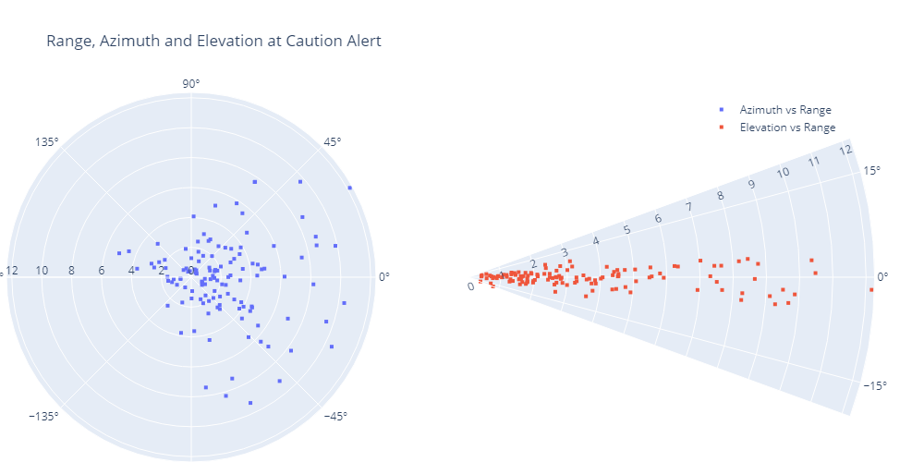
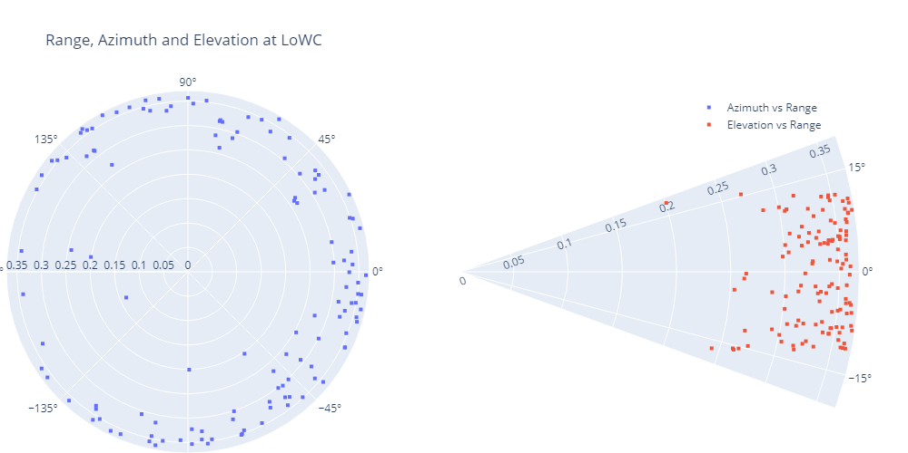
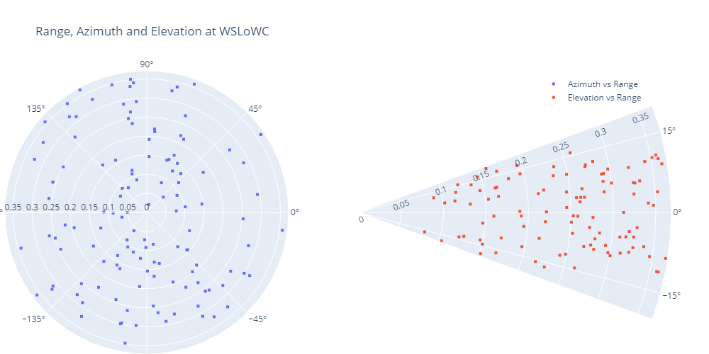
Validation Step 2 – FTS Probabilistic Analysis
Analysis Strategy: Capacity of active sensors to detect non-cooperative
Evaluation of encounter at critical points: caution alert, LoWC, and WSLoWC: DMOD Volume.

Slide 31
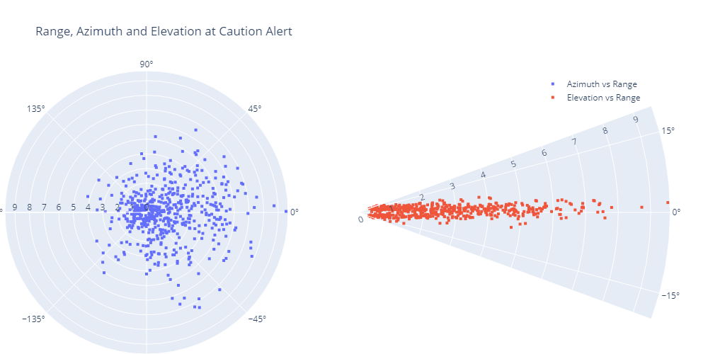
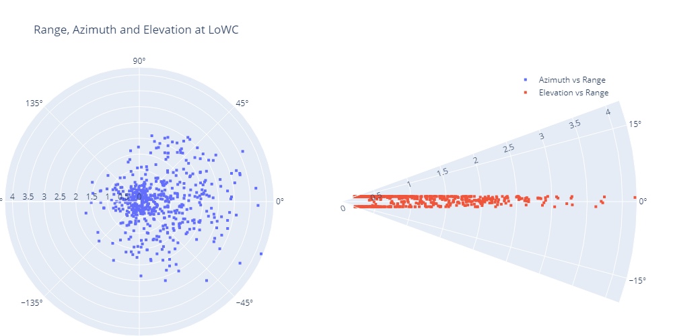
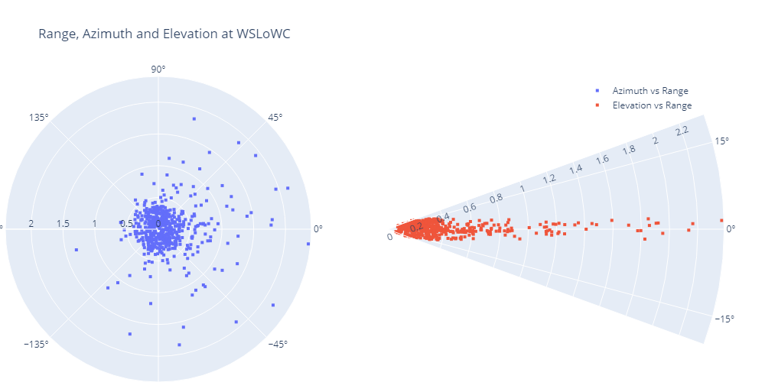
Validation Step 2 – FTS Probabilistic Analysis
Analysis Strategy: Capacity of active sensors to detect non-cooperative
Evaluation of encounter at critical points: caution alert, LoWC, and WSLoWC: DMOD + Taumod Volume.

Slide 32
THANK YOU FOR
YOUR ATTENTION

